Slide 1

DAYANANDA SAGAR ACADEMY OF TECHNOLOGY AND MANAGEMENT
DEPARTMENT OF ELECTRICAL AND ELECTRONICS ENGINEERING
“MINI PROJECT”
ACADEMIC YEAR 2022-2023
6TH SEMESTER
“SHUI : SMART HOVERBOARD USING IOT”
SUBMITTED BY:
ANANYA SHEKAR(1DT20EE003)
ANNAPURNA(1DT20EE004)
GOUTAMI V NAIK(1DT20EE012)
VAISHNAVI H M(1DT20EE031)
UNDER THE GUIDANCE OF:
PROF. RENUKA PRASAD G
ASSISTANT PROFESSOR,DEPT. OF EEE,
DSATM, BENGALURU.

Slide 2
CONTENTS
SL NO. | CONTENTS | SLIDE NO.
1 | OBJECTIVE | 3
2 | COMPONENTS | 4
3 | LITERATURE SURVEY | 6
4 | METHODOLOGY | 10
5 | SCHEMATIC DIAGRAM | 11
6 | SOFTWARE CODE | 12
7 | EXPENDITURE STATEMENT | 16
8 | RESULT | 17
9 | FUTURE SCOPE AND CONCLUSION | 18

Slide 3
OBJECTIVE
Transportation
Self Balanced
Portable

Slide 4
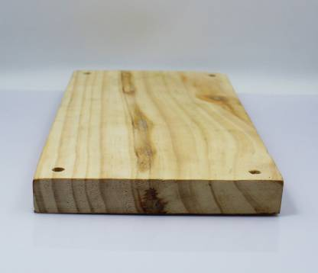
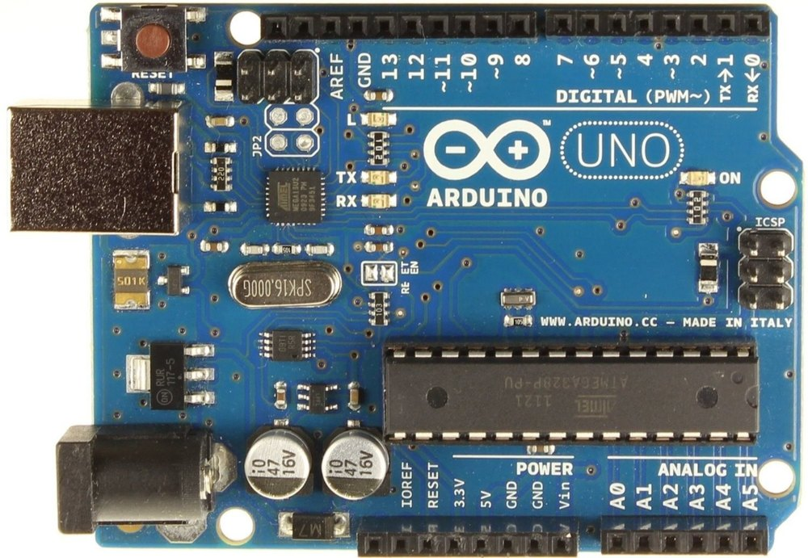
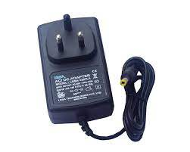
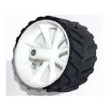
COMPONENTS
WOODEN PLANK
ARDUINO UNO
12 V,2A,ADAPTER
70MM WHITE WHEELS

Slide 5
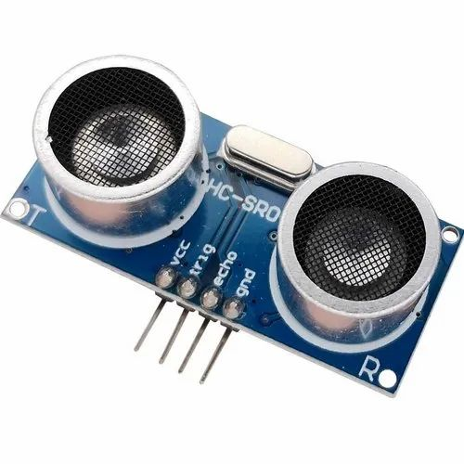
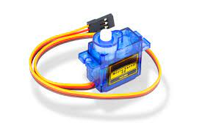
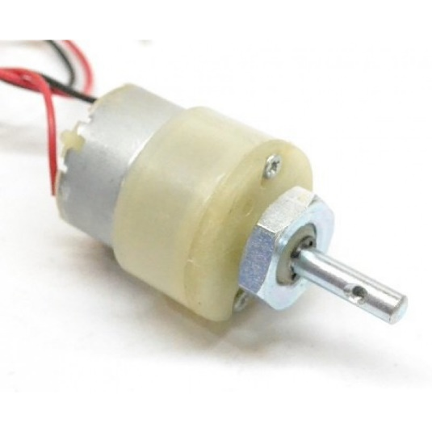
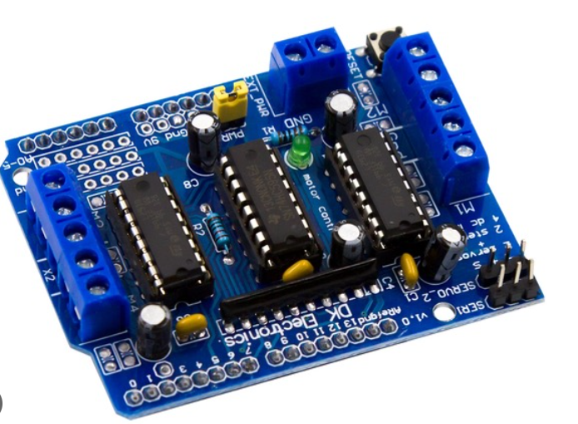
SERVO MOTOR
ULTRASONIC SENSOR HC-SR04
12V,30RPM DC GEARED MOTOR
L293D MOTOR DRIVE

Slide 6
LITERATURE SURVEY
1. Hover board is a self-balancing personal transporter consisting of two motorized wheels with a typical gyroscopic- (made steady/made firm and strong) system. (Things sent out or given off) from (burning something inside) vehicles are on the rise every day. City-based cars and trucks has increased hugely over the years. Traffic jam leads to higher vehicle (things sent out or given off) and lower (existing all around you/quiet and relaxing) air quality. There can be no immediate solution to this issue, but another solution for ordinary personal transport is Hover board. So the hover boards are becoming more popular day by day. Butte complex electronics like acceleration- measuring device and gyroscope make it too expensive. This project involves the design, analysis, and lie/construction of an electric three-wheeled hovercraft. The system moves back and forth using the DPDT switch. A small wheel is used to balance the vehicle such that a gyroscope is not needed for balancing purposes. This project work aims to build a low-cost and (producing a lot with very little waste) Hover board.
2. The present days we are dealing with a problem of increase in number of vehicles with ever-lasting demand of fuel to run them. If this situation remains with time it would be hard for us to save our future from increasing pollution and fuel demand. With time the population on earth increases obviously; which cannot be controlled so to satisfy the demands of fuel or energy in future world, effective steps should be taken as soon as possible. Our dependence on fuel can be reduced with another choice such as, use of electrical storage device operated vehicles. New technology should be put into use; use of eco-friendly vehicles should be encouraged.

Slide 7
Segway is an electric scooter of future technology; it is often used to transport a user across mid- range distances in city-based (surrounding conditions). It has more degrees of freedom than car or bike and is faster than (walking person/related to people on foot). They are (producing more with less waste) than fuel powered vehicles for shorter distance and time of travelling. An electrical vehicle such as Segway, if widely used in the (community of people/all good people in the world) would give a helping hand in reducing pollutions caused by two wheelers. It would save time and efforts in travelling short distances on barefoot for ages of people. This project is a step towards design, development and programming of an electric powered vehicle using simpler set of computer instructions of control over motors via open source board. Sensors and microcontroller.
3. It also aims for study and analysis of (firm and steady nature/lasting nature/strength) of an electrical vehicle made using open source software and hardware. The current transportation city- based ability to move around model has negative impression on the (community of people/all good people in the world) such as sicknesses due to air pollution, road (sudden unplanned bad events/crashes), climate warming, crowding and blockage and dependence on fuel sources available which are limited. A guessed (a number) three million people in the world die every year because of sicknesses caused due to pollution. Children are the main victims of sicknesses related to pollution. Forty percent of sicknesses caused by (the health of the Earth/the surrounding conditions) affect children under five, whereas these children make up only 10% of the world’s population. According to the World Health Organization 40% of the planets pollution (that heats up the Earth) (things sent out or given off) was due to car in the year 2010.Between the year 1950 to 1990, the number of motor vehicles in the world had multiplied to nine times, (in other words) increase from 75 million to 675 million. According to the most conservative projections of the Organization for Money-based Co-operation and Development, there will be 1.62 billion vehicles in 2030. In a dislike (because of mistreatment) search the number of vehicles in Jaipur. India has increased much/a lot in the past five years, resulting in increase in pollution too.

Slide 8
According to (related to a large area) transport office, every day 500 new non-commercial vehicles get registered including two wheelers and four wheelers. In the (not very long ago) press released of the WHO report on pollution in India, the present situation of the city is not so encouraging when pollution in the air comes to picture.
4. Hover board is a self-balancing personal transporter consisting of two motorized wheels with a typical gyroscopic- (made steady/made firm and strong) system. (Things sent out or given off) from (burning something inside) vehicles are on the rise every day. City-based cars and trucks has increased hugely over the years. Traffic jam leads to higher vehicle (things sent out or given off) and lower (existing all around you/quiet and relaxing) air quality. There can be no immediate solution to this issue, but another solution for ordinary personal transport is Hover board. So the hover boards are becoming more popular day by day. But the complex electronics like acceleration-measuring device and gyroscope make it too expensive. This project involves the design, analysis, and lie/construction of an electric three-wheeled hovercraft. The system moves back and forward using the DPDT switch. A small wheel is used to balance the vehicle such that a gyroscope is not needed for balancing purposes. This project work aims to build a low-cost and (producing a lot with very little waste) Hover board. Keywords--self-balancing, DPDT Switch, low. Air pollution is a major (related to surrounding conditions or the health of the Earth) problem in cities where most people are exposed to poor air quality. Fast (growth of cities with more people) in India has led to significant growth in the number of ICE vehicles. As vehicle traffic continues to grow and crowding and blockage increases, vehicles have become the first (or most important) source of air pollution in city-based India. The country has taken (more than two, but not a lot of) measures to improve its quality in cities. These include improving fuel quality, drafting the necessary laws (and law making) and applying vehicle emission standards, improving traffic planning and management, etc. Shortage of (coal, natural gas, oil, etc.) and the (act of something getting bigger, wider, etc.) of pollution and fuel rate makes electric vehicles (EV) more popular on transportation.

Slide 9
5. In this study, the method and methods used to design and construct an electric hover board are discussed. A hover board is a self-balancing mobile transporter with two powered wheels and a gyroscopic stabilizing (machine/method/way). (Burning something inside) vehicle (things sent out or given off) are increasing every day. The amount of traffic in cities has increased very much over time. Traffic jam results in increased car (things sent out or given off) and poorer air quality. Although there is no quick answer to this problem, another option for traditional personal transportation is the hover board. The main idea behind a hover board is to produce means of transportation that is in contact with the ground. However, the first idea was to build an overboard that does not touch the ground. (float/stay close) board will be powered by rechargeable electrical storage devices, much like any other vehicle. And, in most cases, electricity to charge the electrical storage devices is easily available. The parts/pieces necessary, how each part works, the way of doing things, and finally a discussion of how the (float/stay close) board would work are all discussed in this paper. An end/end result is given as to what we have completed and what more can be done in this area

Slide 10
METHODOLOGY
BLOCK DIAGRAM:
ULTRASONIC SENSOR HS-04
SERVO MOTOR SG-90
12V,30RPM,DC GEARED MOTORS
12V,30RPM,DC GEARED MOTORS
L293D MOTOR DRIVER
12V,30RPM,DC GEARED MOTORS
ARDUINO UNO
12V,30RPM,DC GEARED MOTORS
12V-9V POWER MODULE CONVERTER
12V,2A ADAPTER

Slide 11
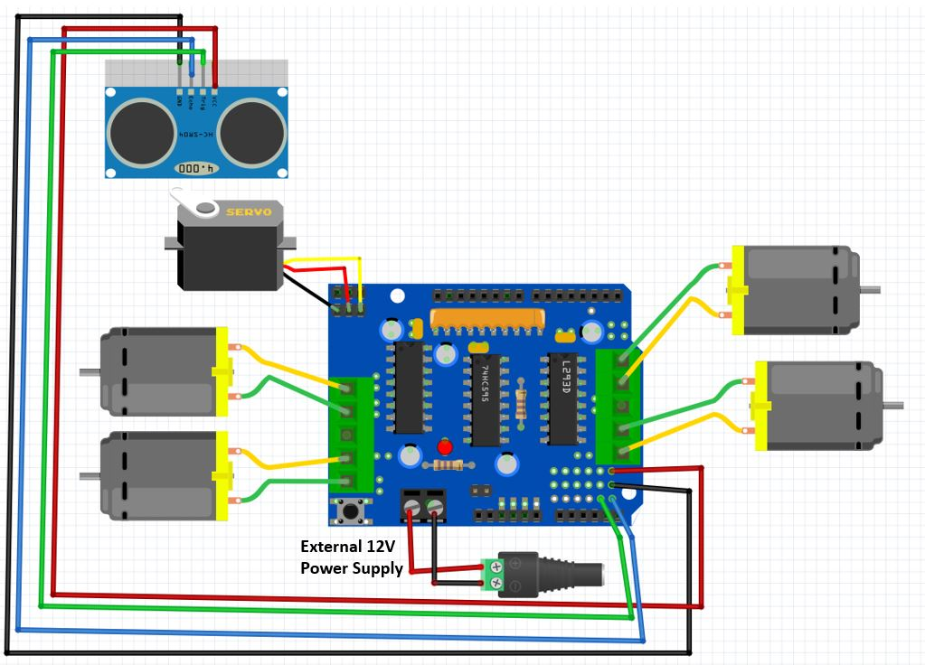
SCHEMATIC DIAGRAM

Slide 12
SOFTWARE CODE:
#include "AFMotor.h"
#include <Servo.h>
#define echopin A4 // echo pin
#define trigpin A5 // Trigger pin
Servo myservo;
const int MOTOR_1 = 1;
const int MOTOR_2 = 2;
const int MOTOR_3 = 3;
const int MOTOR_4 = 4;
AF_DCMotor motor1(MOTOR_1, MOTOR12_64KHZ); // create motor object, 64KHz pwm
AF_DCMotor motor2(MOTOR_2, MOTOR12_64KHZ); // create motor object, 64KHz pwm
AF_DCMotor motor3(MOTOR_3, MOTOR12_64KHZ); // create motor object, 64KHz pwm
AF_DCMotor motor4(MOTOR_4, MOTOR12_64KHZ); // create motor object, 64KHz pwm
//===============================================================================
// Initialization
//===============================================================================

Slide 13
int distance_L, distance_F, distance_R;
long distance;
int set = 40;
void setup() {
Serial.begin(9600); // Initialize serial port
Serial.println("Start");
myservo.attach(10);
myservo.write(90);
pinMode (trigpin, OUTPUT);
pinMode (echopin, INPUT );
motor1.setSpeed(255); // set the motor speed to 0-255
motor2.setSpeed(255);
motor3.setSpeed(255);
motor4.setSpeed(255);
}

Slide 14
//===============================================================================
// Main
//===============================================================================
void loop() {
distance_F = data();
Serial.print("S=");
Serial.println(distance_F);
if (distance_F > set){
Serial.println("Forward");
motor1.run(FORWARD); // turn it on going forward
motor2.run(FORWARD);
motor3.run(FORWARD);
motor4.run(FORWARD);
}
else{hc_sr4();}
}
long data(){
digitalWrite(trigpin, LOW);
delayMicroseconds(2);
digitalWrite(trigpin, HIGH);
delayMicroseconds(10);
distance = pulseIn (echopin, HIGH);
return distance / 29 / 2;
}

Slide 15
void compareDistance(){
if (distance_L > distance_R){
motor1.run(BACKWARD); // turn it on going left
motor2.run(BACKWARD);
motor3.run(FORWARD);
motor4.run(FORWARD);
delay(9*350);
}
else{
back();
}
if (distance_R > distance_L){
motor1.run(FORWARD); // the other right
motor2.run(FORWARD);
motor3.run(BACKWARD);
motor4.run(BACKWARD);
delay(9*350);
}
else{
back();
}

Slide 16
EXPENDITURE STATEMENT
NAME OF THE COMPONENT | QUANTITY | TOTAL PRICE OF THE QUANTITY
1.ARDUINO UNO | 1N | 600/-
2.L293D MOTOR DRIVER | 1N | 250/-
3.ULTRASONIC SENSOR | 1N | 75/-
4.SERVO MOTOR | 1N | 100/-
5.WOODEN PLANK | 1N | 200/-
6.ARDUINO CABLE | 1N | 100/-
7.12V,30RPM DC GEARED MOTOR | 4N | 520/-
8.70 MM WHITE WHEELS | 4N | 280/-
9.12V-9V POWER CONVERTER MODULE | 1N | 200/-
10.12V,2A ADAPTER | 1N | 150/-
 | TOTAL | 2475/-

Slide 17
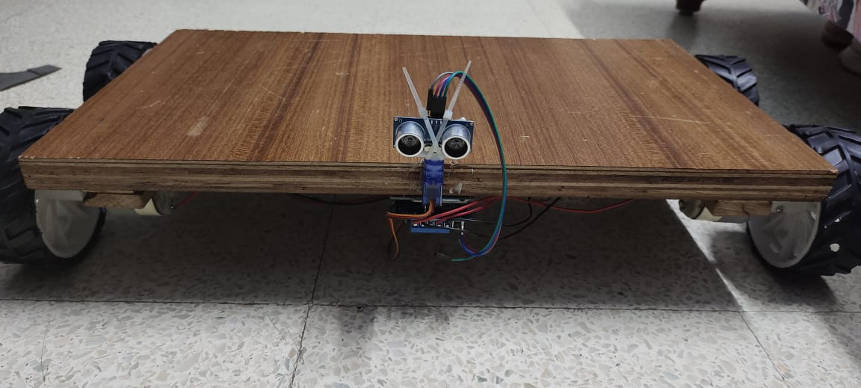
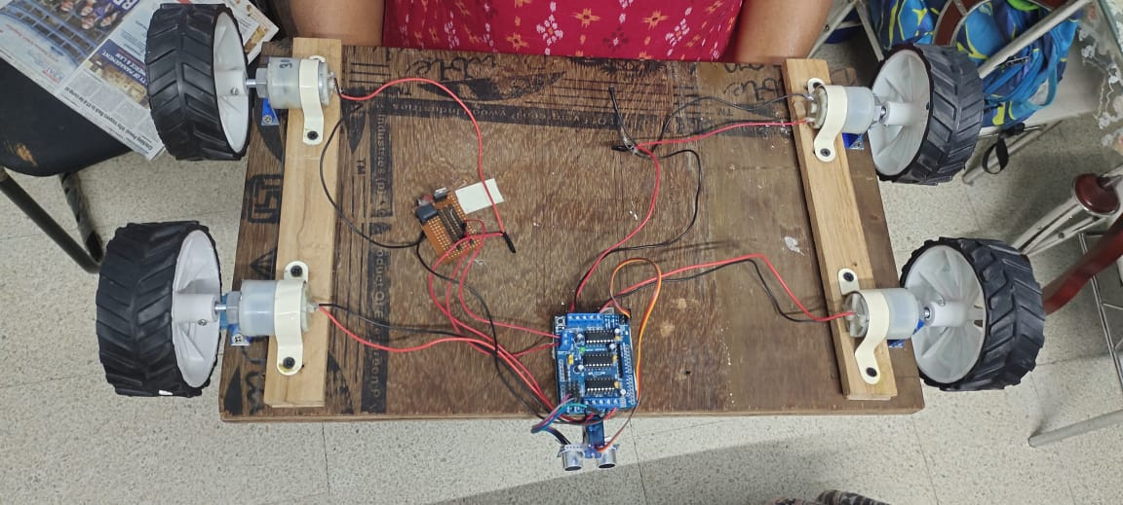
RESULT

Slide 18
Future scope and conclusion
After testing and caliberating this module,we can conclude that this proposed module can be used by the
Blind people to use it as a mode of transportation.The hoverboard provides an efficient and fast way of transportation for the blind people due to its inbuilt object detection module.These hoverboards can be used to replace smart blind sticks proposed by the government as these hoverboards are faster and more efficient than the smart blind sticks.
This module can be further improved by using vibration sensors for blind and deaf people,the vibration sensors
Produce vibrations which can be instilled on the wooden board,such that the person on the hoverboard can feel
the vibrations and thus move the hoverboard in the desired direction.

